Slide 1
Team #112: What the Health
March 16, 2019

Slide 2
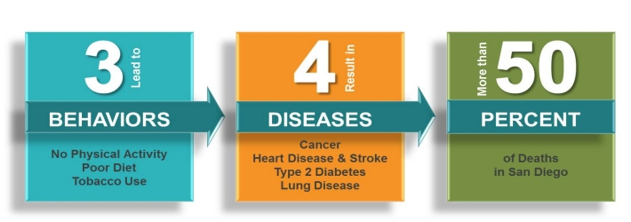
The Problem
3% of San Diegans use the public transit system. Increasing public transportation ridership is a major challenge for transit companies all over the country.
The American Lung Association ranked San Diego the 6th worst city for ozone pollution

Slide 3
Market trends
Why people still use cars
People like the convenience of not waiting for bus/trolley
Bus/trolley may not arrive at exact location
People enjoy the privacy of driving
MTS Financial Report (2018):
Fare revenue’s ability to recover operating costs has decreased from 36.14% to 33.33%
Fare Revenue is only 32% of MTS’s $277 Million Operating Budget in Financial Year 2018
Most funding from grants, subsidies, advertising, tax revenue, environmental/ sustainability programs (such as Low Carbon Transit Operations Program, CA Public Transp. Modernization, Improvement and Service Enhancement Act of 2006, Compressed Natural Gas Rebate)
Notes:
For financial report: Operating revenues have been decreasing and less able to cover expenses….Environmental/Sustainability programs, grants, and legislation promoting reduction in greenhouse gas emissions and improved mobility contribute a lot of funding, but environmental goals aren’t fulfilled, and support from these grants are inefficient when only 3% of San Diego’s population actually use the public transportation systems.
Benefits of public transportation:
Increased activity/ health benefits
Better for the environment
Rider rewards
Reduced traffic congestion

Slide 4
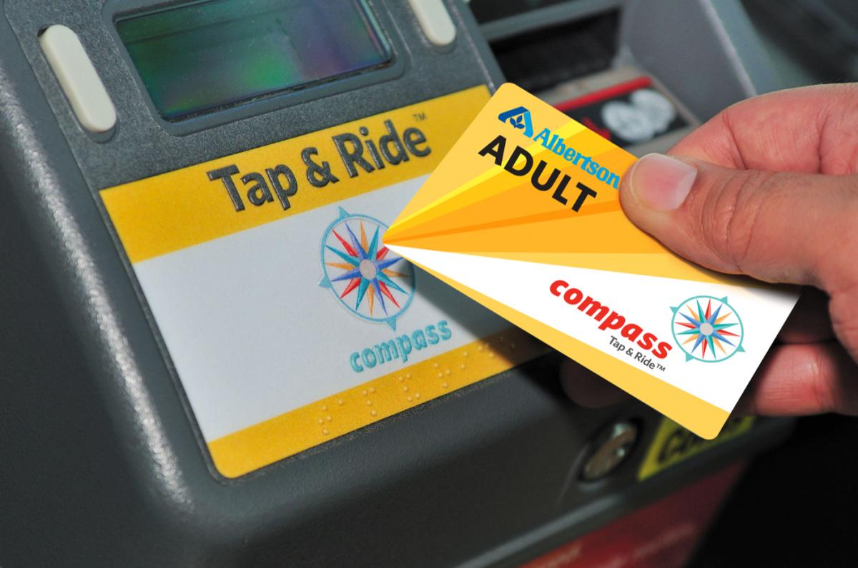
Project objective:
Create a reward/point system to change commuter habit

Slide 5
Benefits of a Public Transit Reward System
Public Health Benefit
Environmental Benefit
Local Economy Benefit
American Heart Association found that people who take public transit are 44% less likely to be overweight, 27% less likely to have high blood pressure and 34% less likely to have diabetes
American Public Transit Association estimates that the use public transit saves an estimated 1.4 billion gallons of gas and 14 million tonnes of carbon dioxide annually
Local business in San Diego will benefit from exposure
Riders save $896 per month by taking transit over driving
MTS can generate more revenue that will go toward improving and creating more bus/trolley routes
Notes:
https://www.apta.com/resources/reportsandpublications/Documents/land_use.pdf

Slide 6
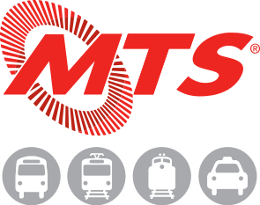
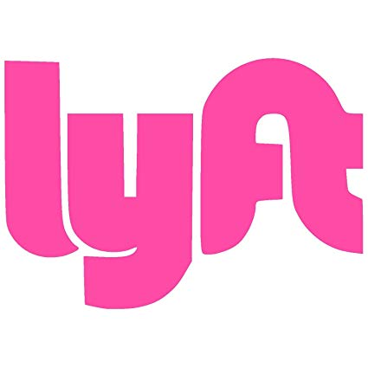

Competitors
Ride Sharing apps
Personal vehicles
MTS Rider Insider
Notes:
While Uber/Lyft may add to traffic and number of cars on the road, their long-term goals include ending reliance on personal vehicles to allow a combination of public transportation and ridesharing apps.

Slide 7
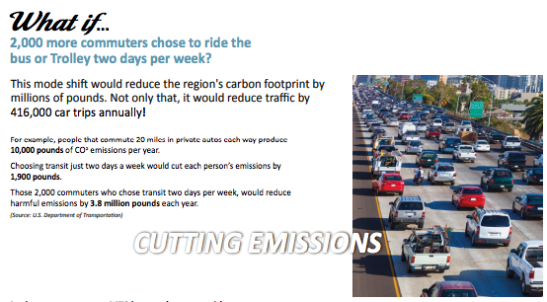
Where this has worked before
Montreal’s Transit Rewards
24% of participants increased their use of transit during the six-month pilot, 57% visited new destinations via transit, and 45% brought a friend along for the ride.
Bart Perks - Bay Area
Currently in beta testing. Enrollment goals have been met, and are no longer accepting more participants. Funded through a $500,000 grant from the Federal Transit Administration.
Connecticut Department of Transportation
Nashville’s WeGo Transit
Notes:
Montreal’s Transit Rewards - Accelerated ridership
Bart Perks - Bay Area. -First pilot ran for 6 months in 2016. Currently in beta testing. Enrollment goals have been met, and are no longer accepting more participants. Funded through a $500,000 grant from the Federal Transit Administration.
Connecticut Department of Transportation - Transit Rewards Over 50 local businesses provided perks to public transportation riders.
Nashville’s WeGo Transit - currently running a pilot program that offers cash to participants. Also rewards users for sharing rides.
Minnesota’s Ride to Rewards - was successfully used to motivate more people to use public transit, but ultimately the metro wasn’t able to continue to fund the program.

Slide 8
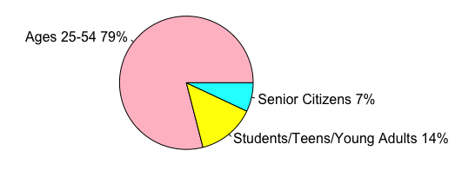
Target audience
Age groups that use public transportation:
Reward Opportunities:
Exclusive perks at local businesses
Free rides
Discounts at stores
Notes:
Specific examples of rewards can include grocery store discounts, reduced museum or amusement park tickets, free bus ride, vip treatment at local restaurants. Can specifically partner with businesses that are located around bus/trolley stops.

Slide 9
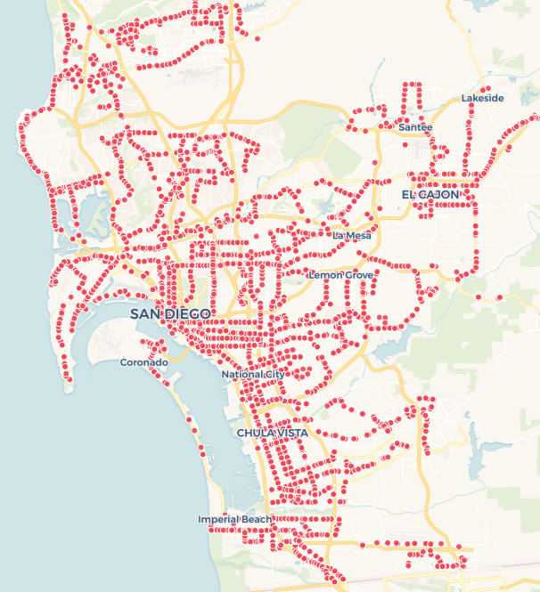
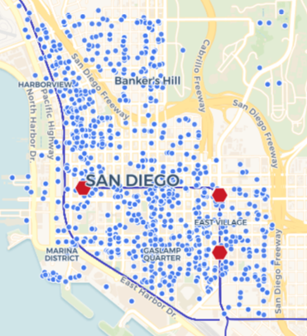
Transit Stops & Local Businesses
datasets: https://data.sandiego.gov/datasets/transit-stops/
https://data.sandiego.gov/datasets/transit-routes/
https://www.sandiego.gov/treasurer/taxesfees/btax/nblactive

Slide 10
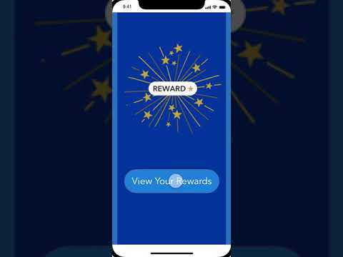
Rewards App
Together, MTS, local businesses, and motivated data scientists can work together to create a loyalty program that will engage and expand their customer bases.
https://xd.adobe.com/view/60773d1b-e8c8-42ef-4ea4-b550b4306279-1646/?hints=off
Notes:
Are the rewards mentioned inthe

Slide 11
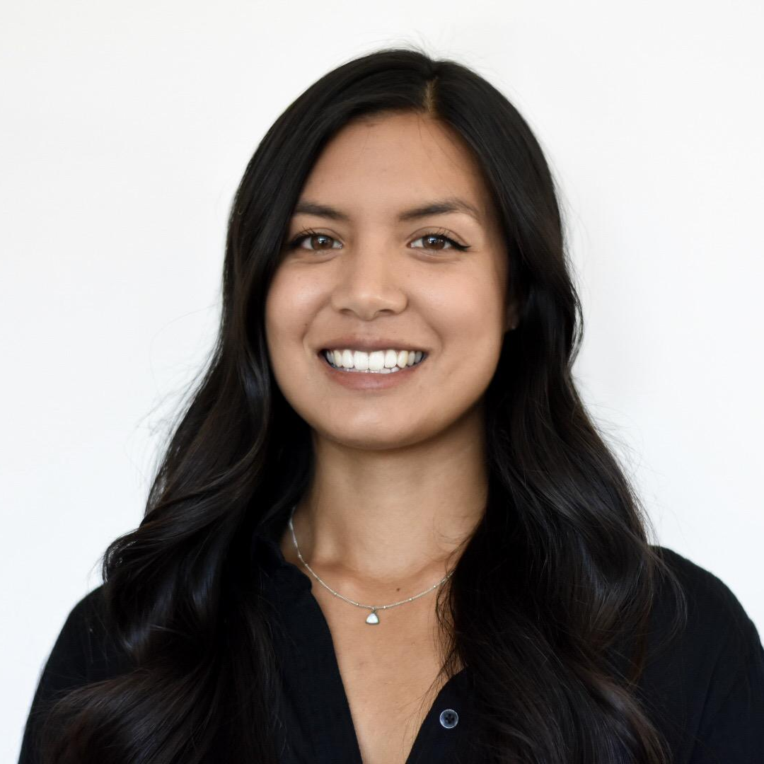
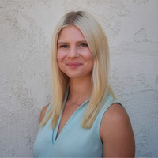
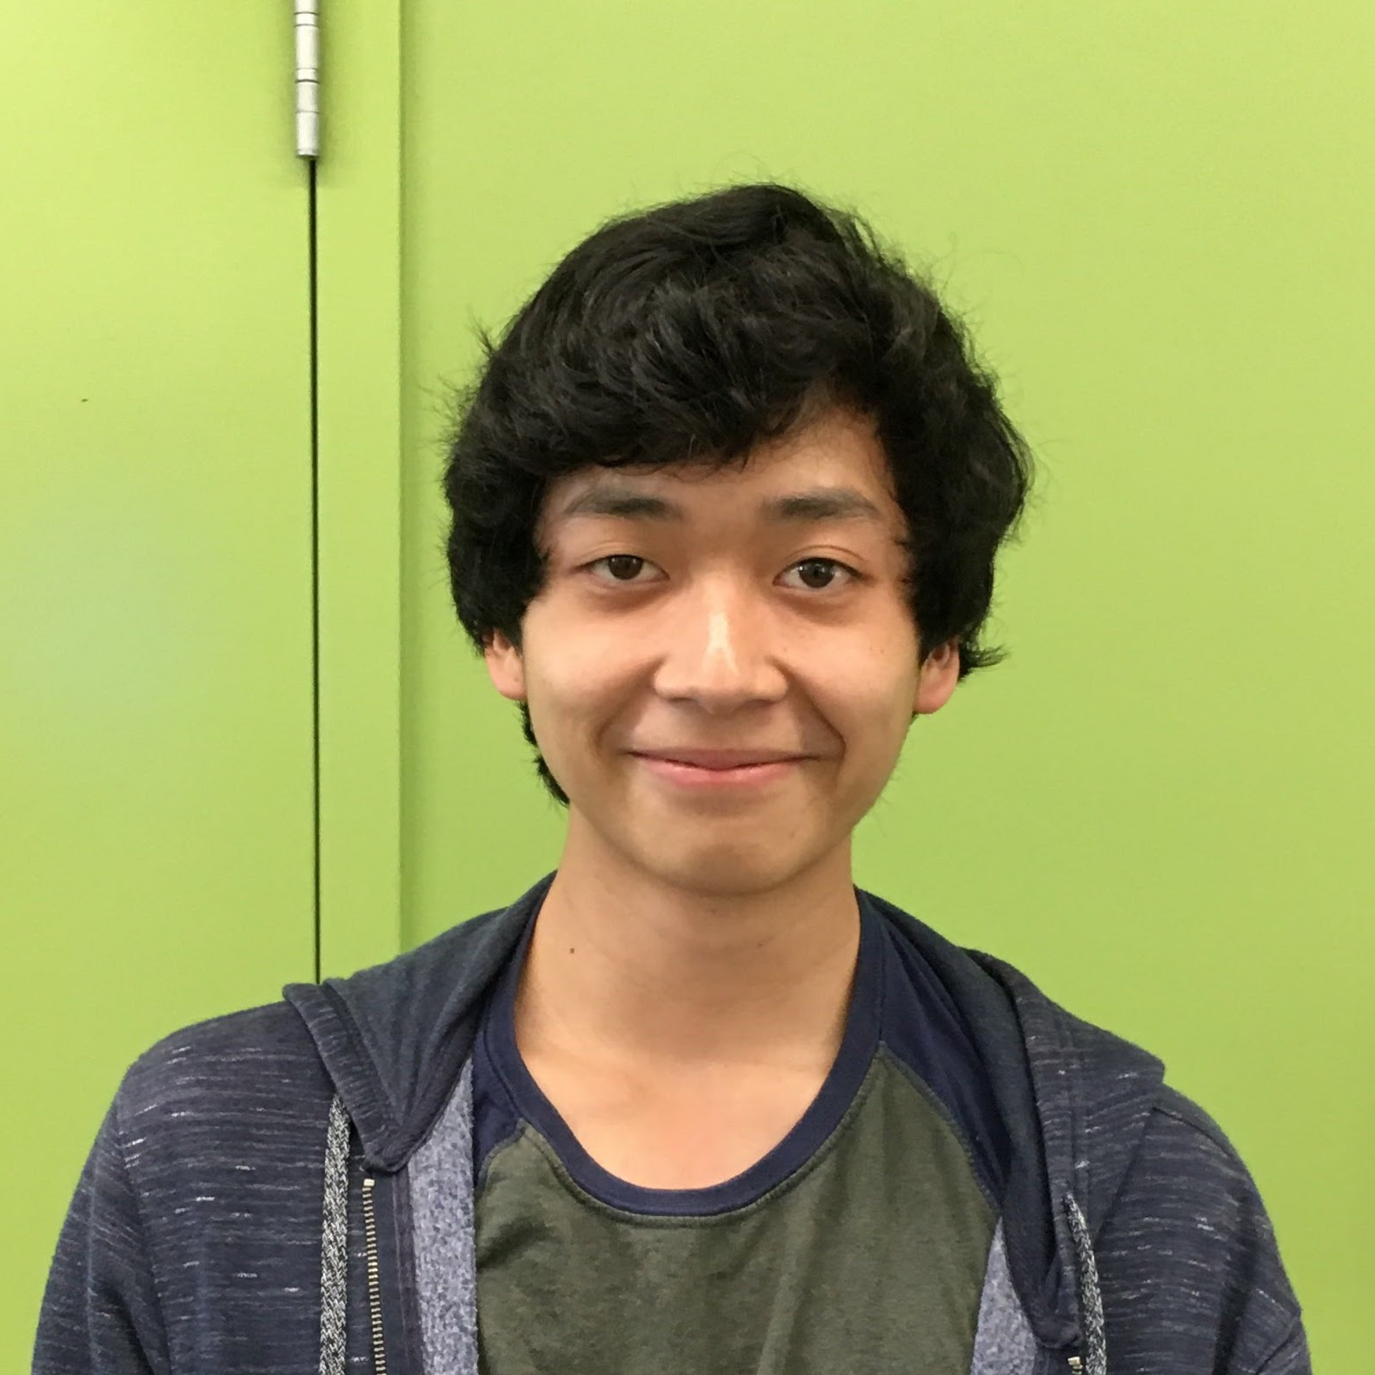
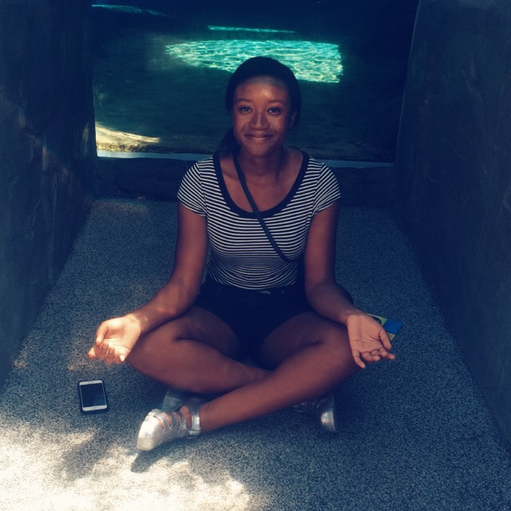
What the Health are we waiting for?!
Emma Westin
Alexa Barnes
Will Tran
Ese Uyovbievbo
Team Coordinator
Masters Student Bioinformatics
Masters Student Bioinformatics
5+ years as Front End Developer
Sophomore, Finance/Accounting
Sophomore, Marketing

